Slide 1

TransferIQ: Revolutionizing Player Valuation
Dynamic Player Transfer Value Prediction Using AI
Presented by [Presenter Name]

Slide 2

Problem & Objective
01
Transfer Market Volatility
The football transfer market experiences frequent fluctuations, impacting player valuations and club strategies.
02
Subjective Scouting Dependence
Many clubs rely on subjective evaluations, leading to inconsistent player assessments and misguided investments.
03
Need for Data-Driven Valuation
There is a growing demand for objective, data-driven approaches to assess player worth, ensuring better decision-making.

Slide 3

DIVERSE DATA SOURCES
MATCH & PERFORMANCE DATA
Integrating performance metrics from multiple data points enhances prediction accuracy.
StatsBomb provides detailed insights into player performances and match statistics.
MARKET & TRANSFER DATA
SENTIMENT ANALYSIS
Transfermarkt offers up-to-date information on player market values and transfers.
Twitter API captures fan sentiment to gauge player popularity and public perception.

Slide 4
LIGHTGBM MODEL
LSTM MODEL
Analyzes complex relationships between features for prediction accuracy.
Captures time-series trends in player performance data.
XGBOOST MODEL
WEIGHTED ENSEMBLE
Utilizes fine-tuned regression techniques for optimal output.
Combines outputs to enhance prediction reliability and accuracy.

Slide 5
FLASK API INTEGRATION
APPLY MULTIPLIERS
The API establishes a connection between models and the front end.
Nationality and minutes played multipliers adjust player valuation dynamically.
ENSEMBLE PREDICTION SIMULATION
RETURN FORMATTED VALUE
The model predicts market value based on weighted ensemble outputs.
The system returns a well-structured market value to the user.

Slide 6
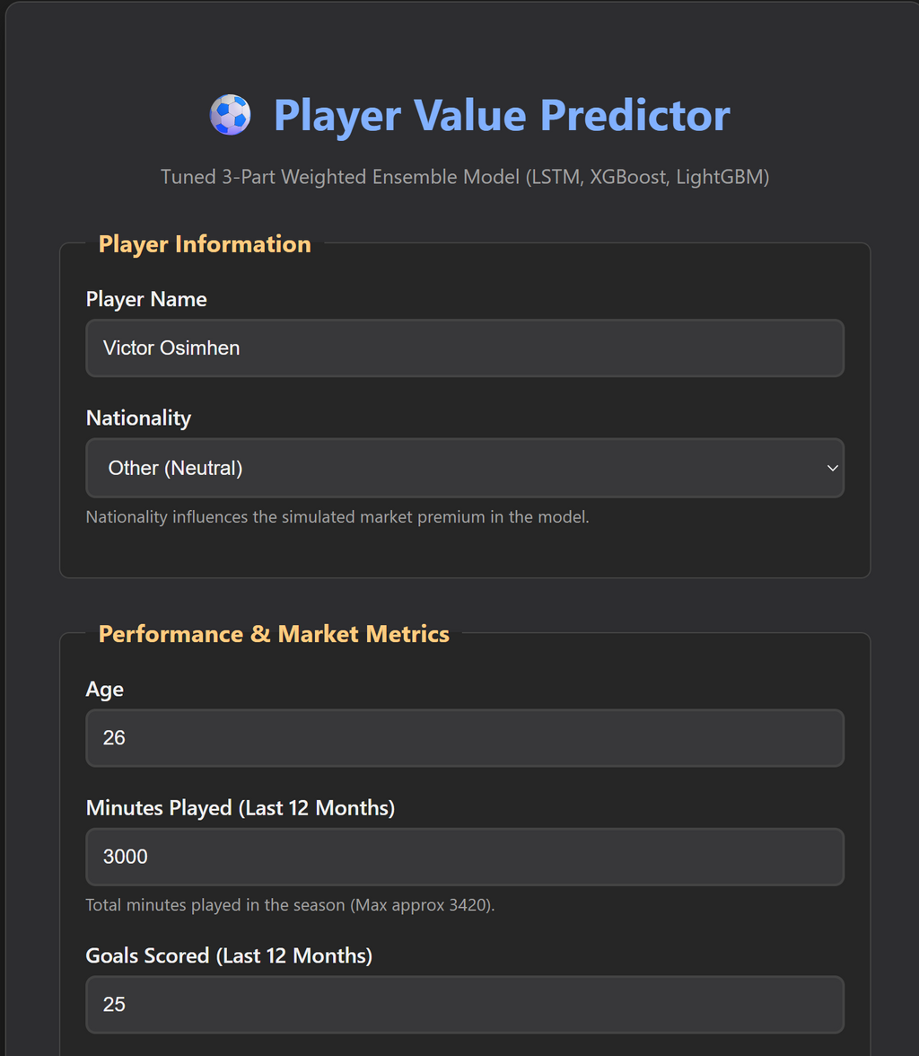


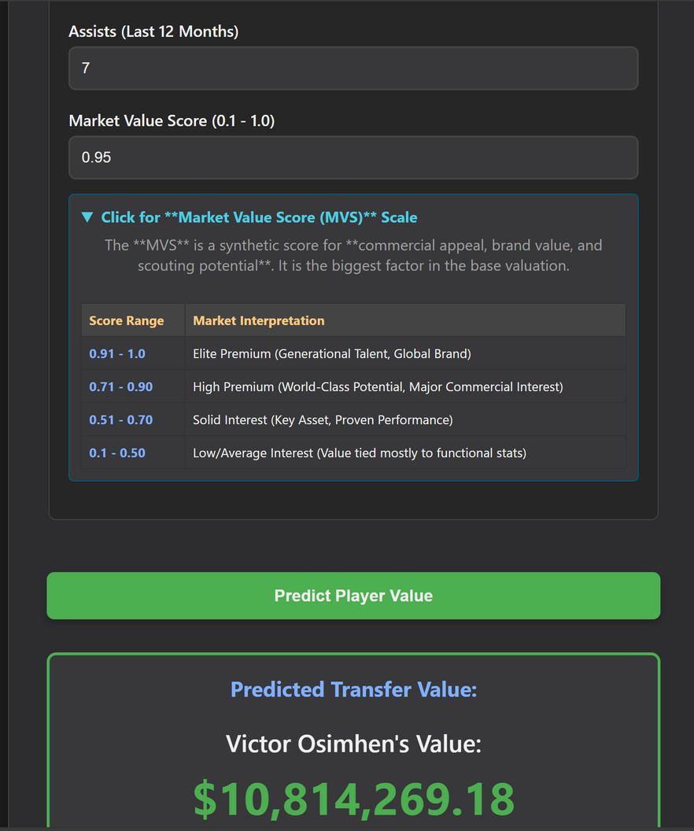
The front-end demo allows users to input player data seamlessly.
This interactive interface processes data in real-time, delivering instant predictions for player transfer values based on integrated AI models.

Slide 7
Results, Impact & Next Steps
01
Improved Accuracy
Our ensemble approach has significantly enhanced prediction accuracy, providing more reliable transfer values to stakeholders.
02
Real-Time Predictions
The system allows for instant value predictions based on player data, empowering teams to make timely decisions.
03
Live Deployment & SHAP Interpretability
Future plans include live deployment of the application along with SHAP interpretations to explain model predictions.

